Slide 1


Traffic light control using reinforcement learning A survey and an open-source implementation
Ciprian Paduraru, Miruna Paduraru and Alin Stefanescu
Department of Computer Science, University of Bucharest, Romania
ciprian.paduraru@unibuc.ro, miruna.paduraru@drd.unibuc.ro, alin.stefanescu@unibuc.ro

Slide 2
Agenda
Introduction
State of the art survey
Our framework
Evaluation
Conclusions and future work

Slide 3
Motivation
People spend more and more hours driving and this causes chaos and pollution.
Smart cities are demanding a smarter traffic light system to optimize these issues
In this perspective, our work is a step forward in helping both research community and industry the problem of traffic light control optimization.

Slide 4
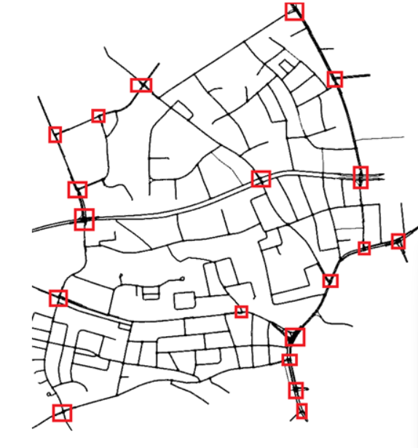
What is traffic light control optimization?
Suppose there is a city / area of a city and we consider a set of intersections (red squares)
Image from https://github.com/LucasAlegre/sumo-rl

Slide 5
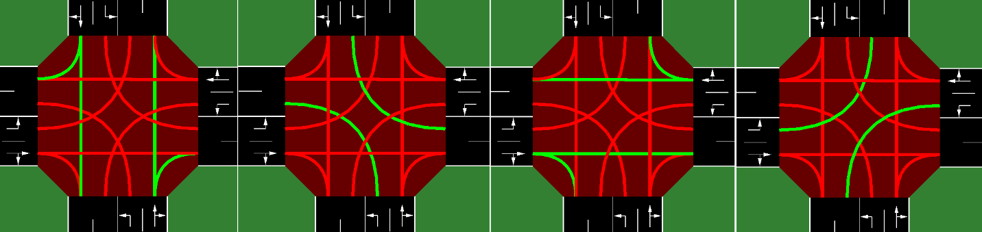
What is traffic light control optimization?
Suppose there is a city / area of a city and we consider a set of intersections (red squares)
Each intersection has a topology. E.g., of a 2-way intersection:
Image from https://github.com/LucasAlegre/sumo-rl

Slide 6
1.2 What is traffic light control optimization?
Suppose there is a city / area of a city and we consider a set of intersections (red squares)
Each intersection has a topology. E.g., of a 2-way intersection:
Each intersection has a sequence of light phases
In the example above there are 4 different phases
Green means lanes allowed to move on.
Image from https://github.com/LucasAlegre/sumo-rl

Slide 7
Some Terminology
Microscopic level - Considering the optimization of individual vehicles (e.g., how long does a vehicle wait at a traffic light), especially when optimizing a single intersection or a series of connected intersections.
Macroscopic level - divides the physical space of the city into streets, lanes, areas and aggregates the metrics and data on large areas.

Slide 8
Terminology
We focus on the microscopic level!
Microscopic level - Considering the optimization of individual vehicles (e.g., how long does a vehicle wait at a traffic light), especially when optimizing a single intersection or a series of connected intersections.
Macroscopic level - divides the physical space of the city into streets, lanes, areas and aggregates the metrics and data on large areas.

Slide 9
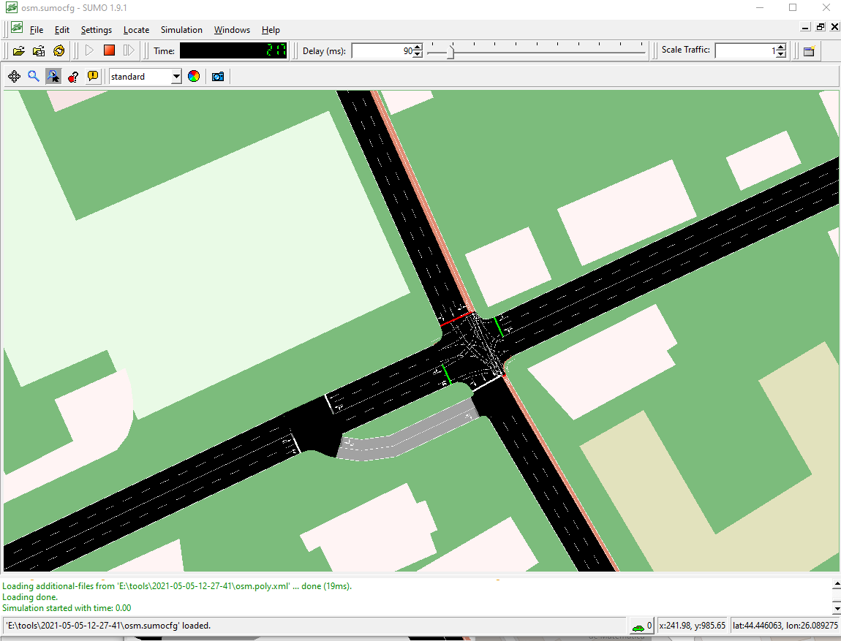
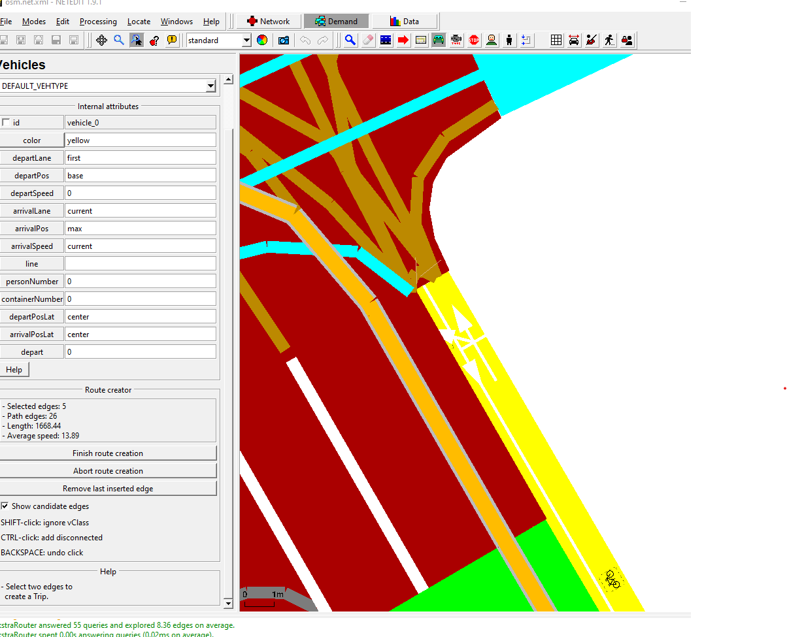
SUMO tool
Simulation of Urban MObility
SUMO is a microscopic, multi-modal traffic simulation.
SUMO is a microscopic, multi-modal traffic simulation
Can use web wizard tool and OSM (Open Street Map) to import real world maps, topologies of intersections and even traffic data!
Has a Python API to interact with the simulation. E.g.:
Change phase of different intersections.
Get statistics from each lane (density, queues, average waiting times, etc.).
Can create datasets using simulated traffic and traffic flow demands – can be very helpful in implementing custom scenarios, such as specific events that might occur in a city.

Slide 10
Why Reinforcement Learning (RL)?
(A) The optimization problem can be first simulated and optimized in a simulated environment until an optimal strategy for timing the traffic light phases is found=> has the potential to reduce costs.
(B) The solution chosen for intelligent traffic light control must be dynamic, making decisions over time that depend on deep insights into the overall state of the city or region being optimized
deep learning opportunity for representing latent in large spaces!
(C) The current state of the art in the use of RL methods outperforms previous work (baseline methods) – see our Related work section in the paper.

Slide 11
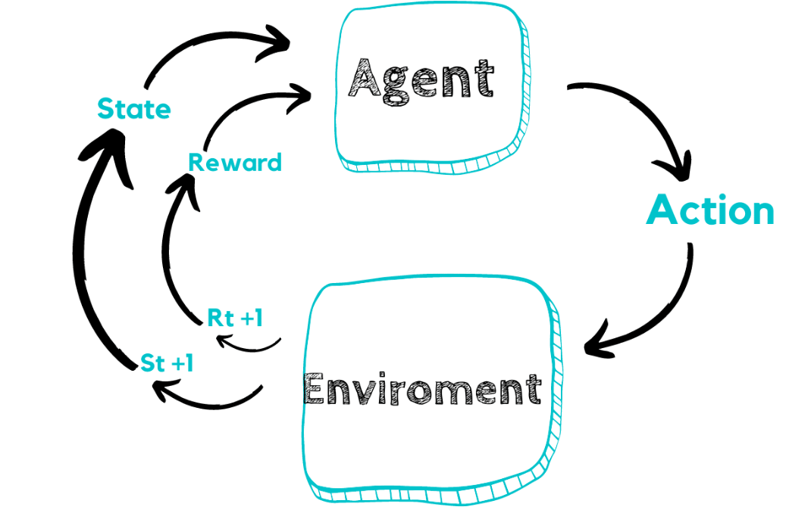
How to apply RL for traffic light optimization?
Main objective: Find a policy that given the state of the environment maximizes the rewards over time.

Slide 12
How to apply RL for traffic light optimization?
Who is the environment?

Slide 13
How to apply RL for traffic light optimization?
Who is the environment?
The city or part of it with all observable intersections

Slide 14
How to apply RL for traffic light optimization?
Who is the agent?

Slide 15
How to apply RL for traffic light optimization?
In single agent mode, a single RL agent is created to control all traffic lights in a given area
Who is the agent?
i.e., a single agent controlling all red intersections.

Slide 16
How to apply RL for traffic light optimization?
In single agent mode, a single RL agent is created to control all traffic lights in a given area
In multi-agent mode, there is a single agent per traffic light that acts cooperatively as a zero-sum game as much as possible
Who is the agent?
i.e., an individual agent for each red intersection

Slide 17
How to apply RL for traffic light optimization?
But what are the Actions? How can an agent act in the environment?

Slide 18
How to apply RL for traffic light optimization?
But what are the Actions? How can an agent act in the environment?
The action space is discrete.
Every delta_time (parameter) seconds, each traffic signal agent can choose the next green phase configuration (usually stay on the same phase or goes to the next one in a continuous cycle).
The next phase is always preceded by a yellow phase lasting yellow_time seconds.
E.g.: In the 2-way single intersection there are |A| = 4 discrete actions, corresponding to the following green phase configurations:

Slide 19
How to apply RL for traffic light optimization?
But what is the State (or Observation)?
What information is available from
the city/traffic system and how it can be mapped in a
numerical format?

Slide 20
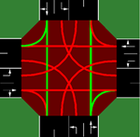
How to apply RL for traffic light optimization?
But what is the State (or Observation) ?
The default observation for each traffic signal agent is a vector:
State = [phase, min_green,
lane_1_density,… ,lane_n_density,
,lane_1_queue,...,lane_n_queue]
phase : one-hot encoded vector indicating the current active green phase
min_green is a binary variable indicating whether min_green seconds have already passed in the current phase
lane_i_density is the number of vehicles in incoming lane i dividided by the total capacity of the lane
lane_i_queue the number of queued (speed below 0.1 m/s) vehicles in incoming lane i divided by the total capacity of the lane
N
E
S

Slide 21
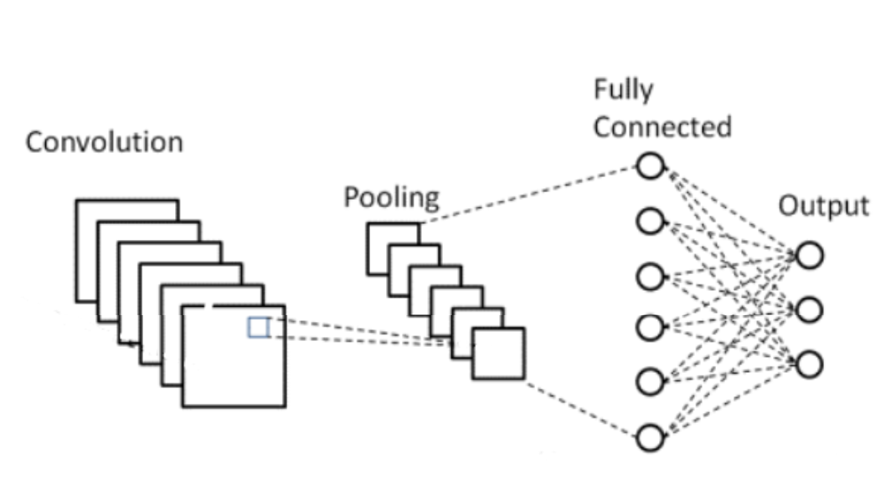
How to apply RL for traffic light optimization?
But what is the State (or Observation) ?
The default observation for each traffic signal agent is a vector:
State = [phase, min_green,
lane_1_density, … ,lane_n_density,
lane_1_queue, ... ,lane_n_queue]
N
State
Decision
E
S

Slide 22
How to apply RL for traffic light optimization?
But how do we compute Rewards after decisions taken?

Slide 23

How to apply RL for traffic light optimization?
But how do we compute Rewards after decisions taken?
E.g., How much the total delay - sum of the waiting times of all approaching vehicles) changed in relation to the previous time-step.

Slide 24


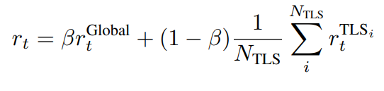
How to apply RL for traffic light optimization?
But how do we compute Rewards after decisions are taken?
Or the default state-of-the-art implementation:
Local reward: measures the different between the number of vehicles in the intersection between directions WE and NS
Global reward: Measures the difference between how many vehicles have passed and how many entered in the intersection
N
Total reward: a blend of the to components above, where β starts in the training process from 0 and gets to 1 – intuitively, the agent is trained to optimize locally then by the end it looks for global optimization.
W
E
S

Slide 25
Our framework
Open-source at https://github.com/unibuc-cs/TrafficFlowOptimization
First open-source tool at the microscopic level that can leverage various modern single and multiagent algorithms from popular open-source RL libraries such as:
TFAgents (Guadarrama et al., 2018)
OpenAI Baselines (Dhariwal et al., 2017)
PFRL (Fujita et al., 2021),
RLlib (Liang et al., 2018).

Slide 26
Framework that allows separation between the methods used for optimization and the knowledge and datasets of transportation administration
RL researchers can reuse their expertise more easily and with less technical effort to perform optimizations without knowing deep technical details about traffic management in general.
users who are familiar with traffic management concepts can immediately reuse existing open-source RL libraries out of the box with minimal knowledge in this area.
Domain adapted output capabilities
Comprehensive list of output options with relevant default metrics for real-world traffic scenarios
Plotting functions built on top of TensorBoard (TensorBoard, 2021), specifically adapted for the metrics of the traffic light control problem.

Slide 27
Distributed training with RLlib using strategies to connect to the SUMO simulator (Krajzewicz et al., 2012). Multiple workers and environments per workers variants are supported.
A method to simulate traffic under various conditions, in real-world maps, even in the absence of real-world data.

Slide 28
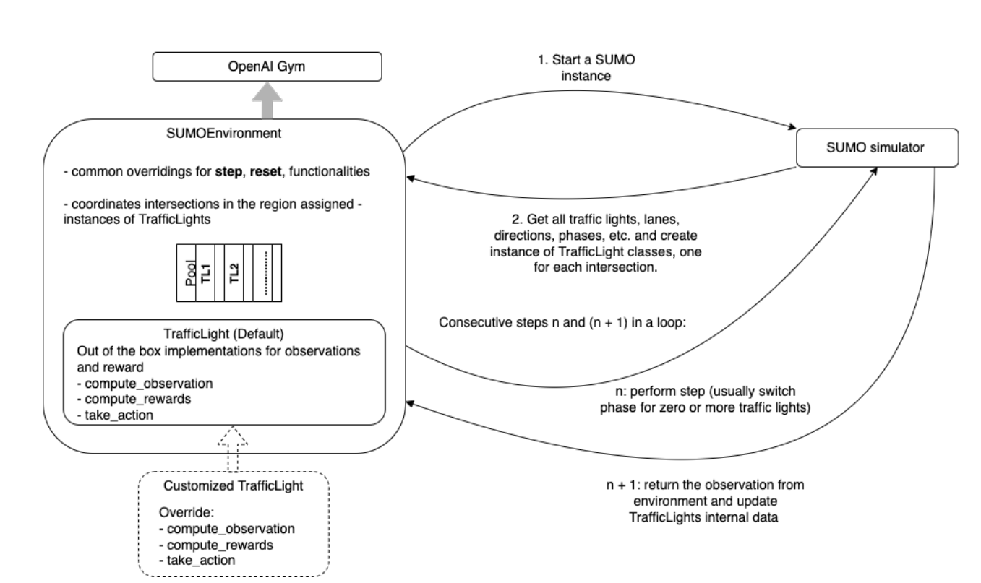
Interaction flow between OpenAIGym environment, our SumoEnvironment environment and the SUMO simulator

Slide 29
Interaction flow between OpenAIGym environment, our SumoEnvironment environment and the SUMO simulator
User can override the default behaviors!
Various state of the art implementations are provided out of the box for experimentation

Slide 30
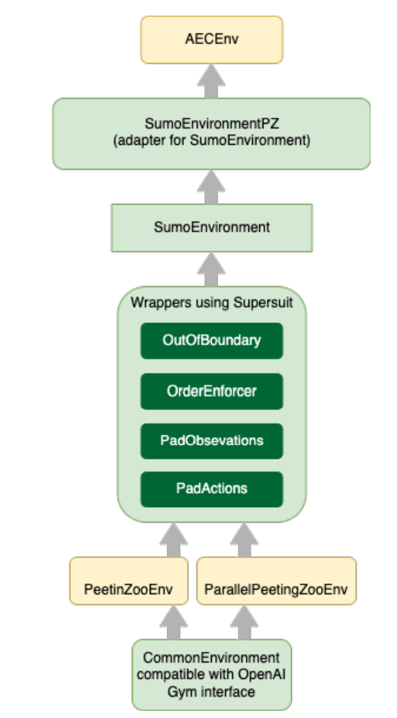
Software stack for environment
The framework implements an environment compatible with OpenAI Gym interface => need by the research community in RL and to be compatible with the common RL libraries out of the box

Slide 31
Software stack for environment
The framework implements an environment compatible with OpenAI Gym interface => need by the research community in RL and to be compatible with the common RL libraries out of the box
Preprocessing hooks created with the SuperSuit tool: PadActions and PadObservation - to populate the observation and action spaces so that all agents have the same dimensionality, regardless of the number of lanes each traffic light agent has
AECEnv is the foundation, implemented in the PeetingZoo library based on the Agent Environment Cycle Game (Terry et al., 2021) idea, and the SumoEnvironment class.

Slide 32
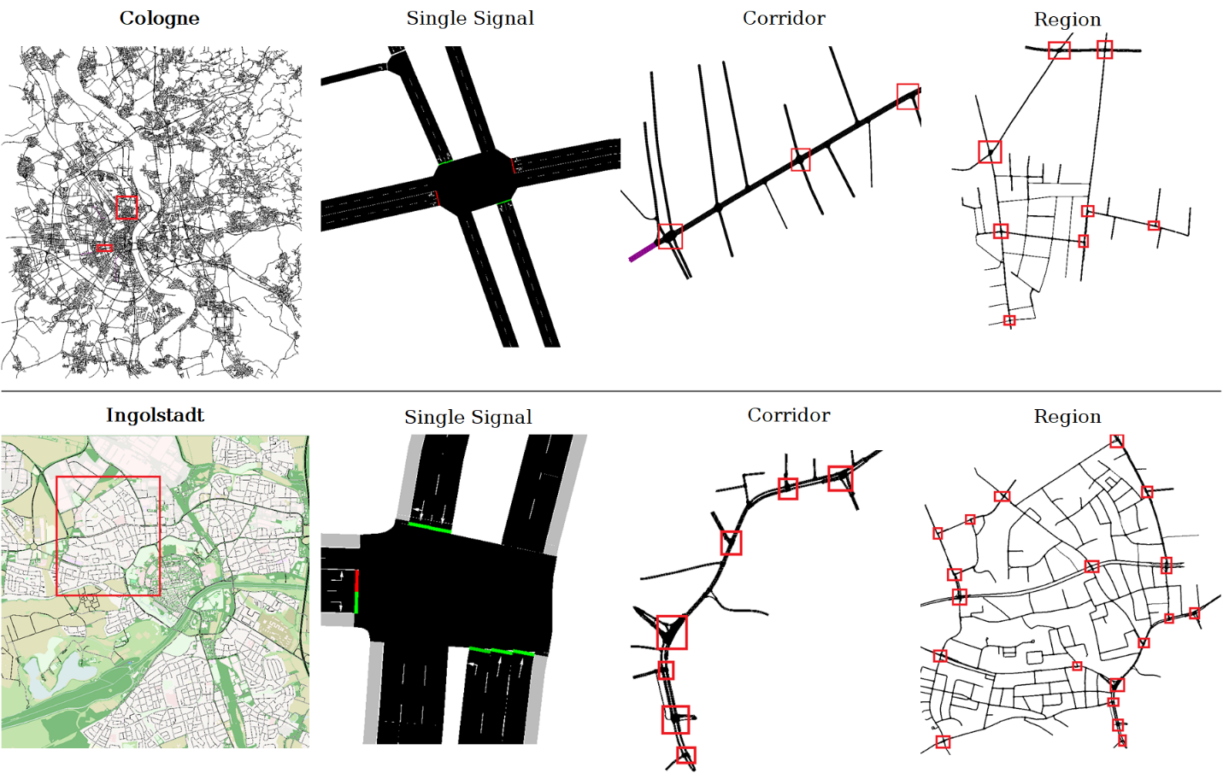
Evaluation
We used RESCO dataset for evaluation and experiments,
Paper: https://people.engr.tamu.edu/guni/Papers/NeurIPS-signals.pdf
Github: https://github.com/LucasAlegre/sumo-rl

Slide 33
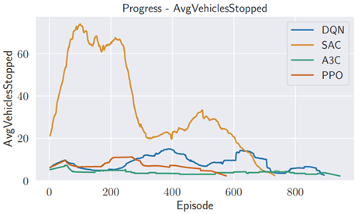
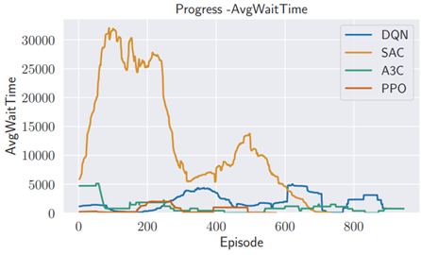
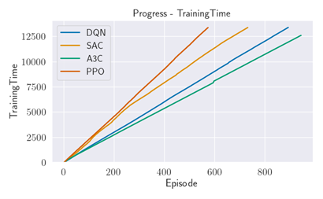
Evaluation
We provide out of the box implementations for different algorithms.
Domain adapted statistics such as: statistics about vehicles stopped, waiting time for vehicles, training efficiency, etc.
User can create its own dataset using our tools and experiment.

Slide 34
Conclusions
Reinforcement learning is currently the best way to simulate and optimize traffic lights control in smart cities environments.
Our framework acts from two sides:
It allows research and industry communities to experiment different methods without having to understand low-level details about traffic management, datasets, or code.
It allows people with traffic management knowledge to create datasets, customize and experiment changes to existing cities topologies, without having to understand the algorithms for optimizations.

Slide 35
Check out our open-source tool at
https://github.com/unibuc-cs/TrafficFlowOptimization

